Slide 1
Week 3

Slide 2


Class Announcements (11/27/2023)
Motivation
Primitive vs Non-Primitive Data type.
Numbers
Strings Class Link Recordings

Slide 3
Primitive vs Non-Primitive Data Types
Primitive
Non-Primitive / Object
Strings
Numbers
Boolean
Null
Undefined
Symbol
Array
Object
Functions

Slide 4

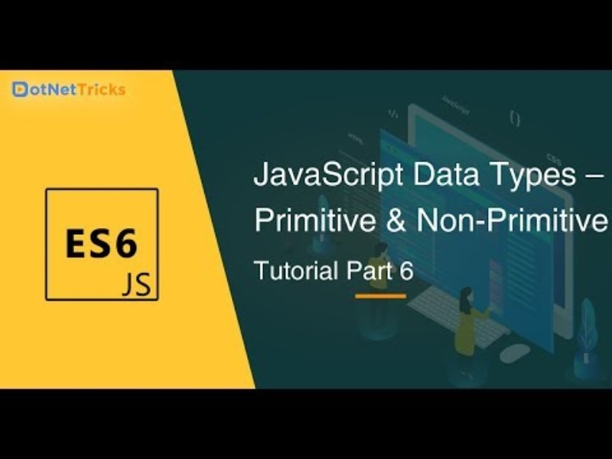

Slide 5
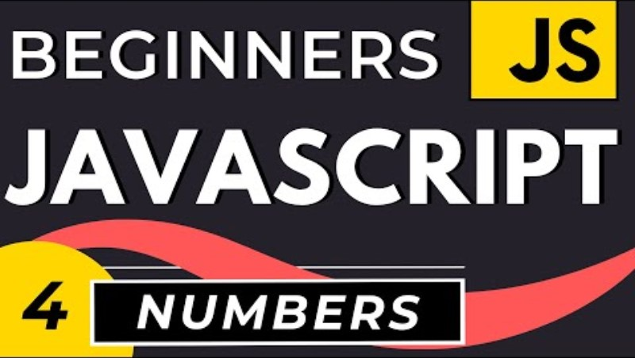

Slide 6


Slide 7
Homework Due Tuesday 11/28/2023
Appending Variables to Strings
Find the Length of a String
Use Bracket Notation to Find the First Character in a String
Understand String Immutability
Use Bracket Notation to Find the Nth Character in a String
Use Bracket Notation to Find the Last Character in a String
Use Bracket Notation to Find the Nth-to-Last Character in a String
Word Blanks
Store Multiple Values in one Variable using JavaScript Arrays
Nest one Array within Another Array
Access Array Data with Indexes
Modify Array Data With Indexes
Access Multi-Dimensional Arrays With Indexes
Manipulate Arrays With push Method
Manipulate Arrays With pop Method
Manipulate Arrays with Shift Method
Manipulate Arrays With unshift Method
Shopping List
Write Reusable JavaScript with Functions
Passing Values to Functions with Arguments

Slide 8

Class Announcements(11/28/2023)
Motivation
Review
Primitive vs Non-Primitive Data type.
Numbers
Strings
String Objects
Class Activity
Boolean, Null, Undefined
Operators
Window Operators
Class Link Recordings

Slide 9
Class Activity
Declare a variable named challenge and assign it to an initial value ’Welcometo Week 3 JavaScript'.
Print the string on the browser console using console.log()
Print the length of the string on the browser console using console.log()
Change all the string characters to capital letters using toUpperCase() method
Change all the string characters to lowercase letters using toLowerCase() method
Cut (slice) out the first word of the string using substr() or substring() method
Slice out the phrase week 3 from Welcome to Week 3 JavaScript'..
Check if the string contains a word Script using includes() method

Slide 10
Homework Due Wednesday 11/29/2023
Return a Value from a Function with Return
Global Scope and Functions
Local Scope and Functions
Global vs. Local Scope in Functions
Understanding Undefined Value returned from a Function
Assignment with a Returned Value
Stand in Line
Understanding Boolean Values
Use Conditional Logic with If Statements
Comparison with the Equality Operator
Comparison with the Strict Equality Operator
Practice comparing different values
Comparison with the Inequality Operator
Comparison with the Strict Inequality Operator
Comparison with the Greater Than Operator

Slide 11
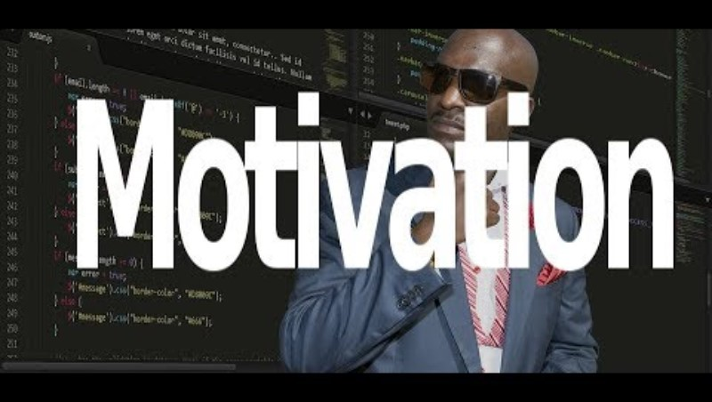
Class Announcements(11/29/2023)
Motivation
Boolean, Null, Undefined
Operators
Window Operators
Class Activity
Class Link Recordings

Slide 12

Class Announcements(11/29/2023)
Motivation
Finish Exercise
Window Operators
Conditionals
Class Activity
Class Link Recordings

Slide 13
Class Activity
Get user input using prompt(“Enter your age:”). If user is 18 or older , give feedback:'You are old enough to drive' but if not 18 give another feedback stating to wait for the number of years he needs to turn 18.
Enter your age: 30
You are old enough to drive.
Enter your age:15
You are left with 3 years to drive.

Slide 14
Compare the values of myAge and yourAge using if … else. Based on the comparison and log the result to console stating who is older (me or you). Use prompt(“Enter your age:”) to get the age as input.
Enter your age: 30
You are 5 years older than me.

Slide 15
If a is greater than b return 'a is greater than b' else 'a is less than b'. Try to implement it in to ways
using if else
ternary operator.
let a = 4
let b = 3
4 is greater than 3

Slide 16
Write a code which can give grades to students according to theirs scores:
80-100, A
70-89, B
60-69, C
50-59, D
0-49, F

